Slide 1

4• 26 • 2024
Ethan Ayari
Dust to Dust
Advisor:
Mihály Horányi
Institute for Modeling Plasmas, Atmospheres and Cosmic Dust (IMPACT) within the Laboratory for Atmospheric and Space Physics (LASP) at CU Boulder

Slide 2
CONTENTS
01
A little about me
Dust dust and more dust
Dust to Dust
02
03
The Terrella and the northern lights

Slide 3

1. About me
I’m a 3rd year Physics PhD student (19th grader) at the University of Colorado Boulder.
I majored in Physics and Math.
I was born in Boulder and have lived in Colorado my entire life.
This is my first time visiting Texas!
I have been working at CUs dust lab since March 2020 as an undergraduate then graduate student.

Slide 4
2. What does a physics phd even do??
Comps I is satisfied by successfully completing five of the six courses below with a grade of B- or better:
Quantum Mechanics 1,2 (PHYS 5250 and PHYS 5260)
Electromagnetic Theory 1,2 (PHYS 7310 and PHYS 7320)
Statistical Mechanics (PHYS 7230)
Theoretical Mechanics (PHYS 5210)
Comps II consists of the preparation of a formal paper that summarizes a broad research topic. The student then delivers an oral presentation about the content of the research paper and takes an oral examination on the research topic as well as his/her general knowledge of physics.
Comps III is a roadmap to graduation, making sure that you’ll finally stop going to school one day!

Slide 5
3. Did you say dust?
Yes, I did!
But not your common household dust.
Cosmic dust can refer to minerals, metals, ice or organic material

Slide 6
4. The dust lab
https://impact.colorado.edu/
Originally we were the Nuclear Physics Lab, but the people of Boulder weren’t too enthusiastic about living near radioactive isotopes :(
The dust lab took over the building in 2006 and has been running since! :)

Slide 7
5. The dust accelerator
First assembled in 2012
Dust particles are accelerated to speeds of 3-97 km/s (That’s 216,983 mph!)
We accelerate mineral, metal and organic dust particles coated in a conducting layer.

Slide 8
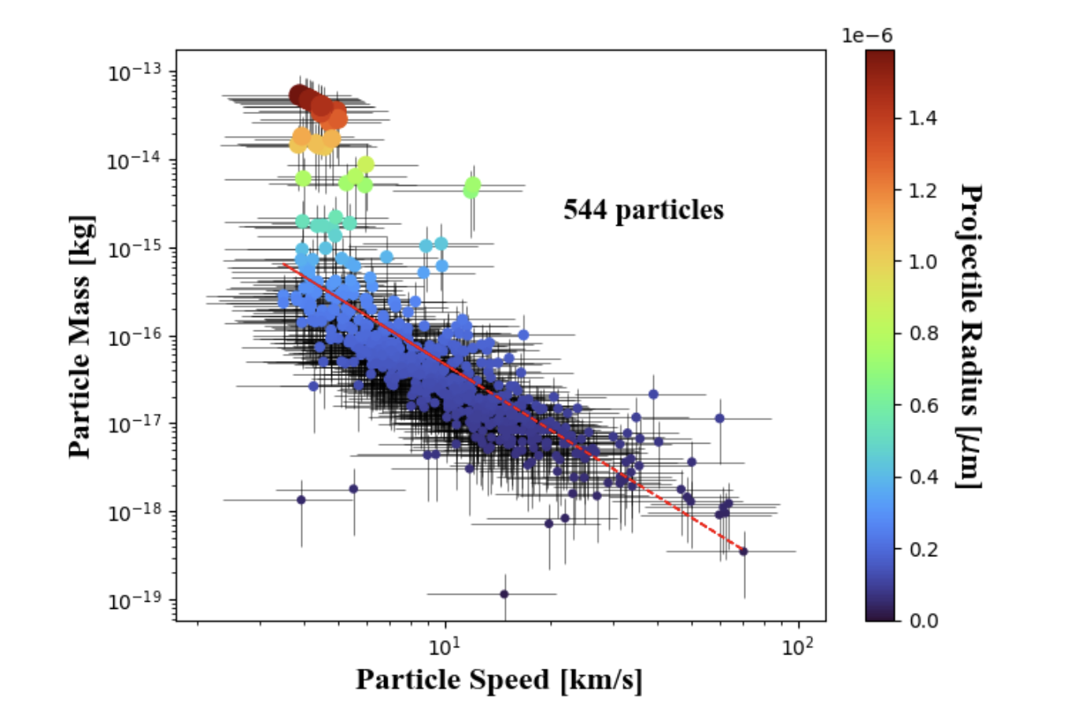
6. Dust accelerator experiments

Slide 9
7. Dust instruments (why?)

Slide 10
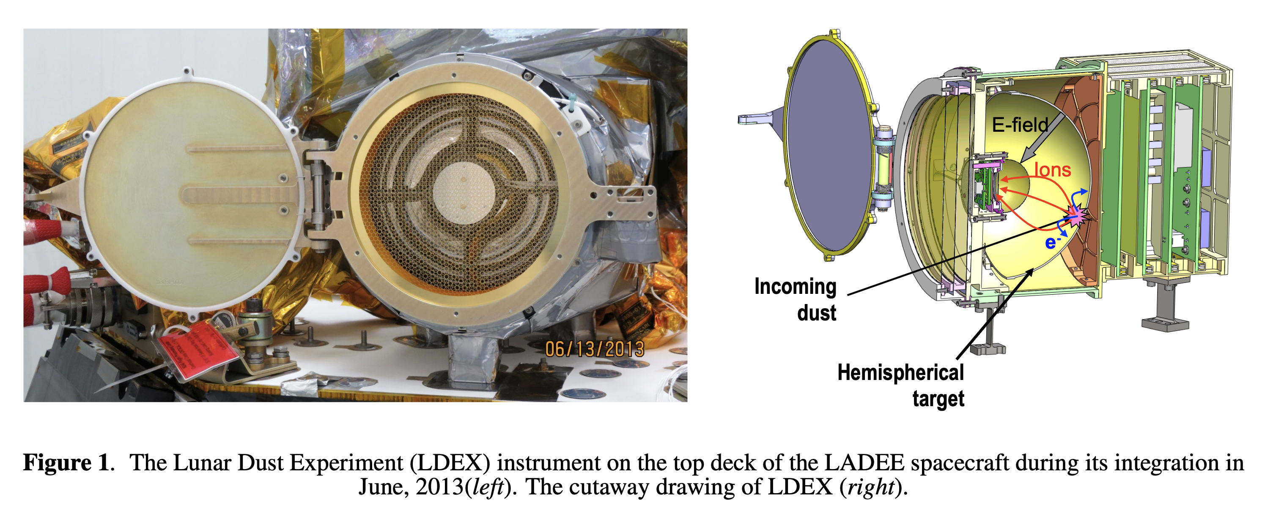
8. The lunar dust experiment
NASA’s Lunar Atmosphere and Dust Environment Explorer LADEE mission was launched on September 6, 2013; and it reached lunar orbit a month later on October 6, 2013.

Slide 11
9. My mission (IMAP)
https://youtu.be/RYf99iiwdPg
https://www.colorado.edu/today/2024/01/11/new-instrument-capture-stardust-part-nasa-mission

Slide 12
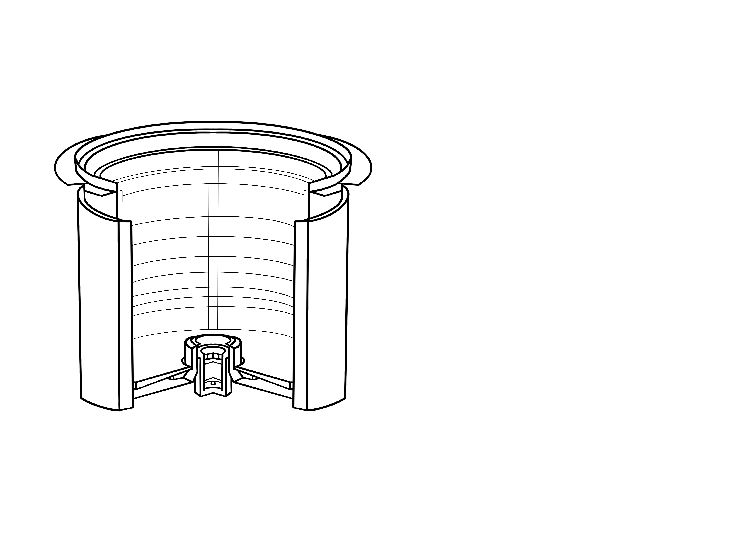
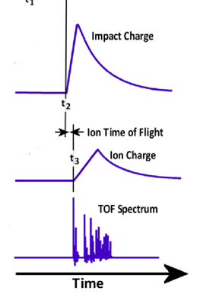
9. My mission (IMAP)
60 cm
Incoming Dust
Impact Ions
Target Charge Signal
Detector
Ion Grid Signal
TOF Mass Spectrum
News video: https://youtu.be/RYf99iiwdPg.

Slide 13
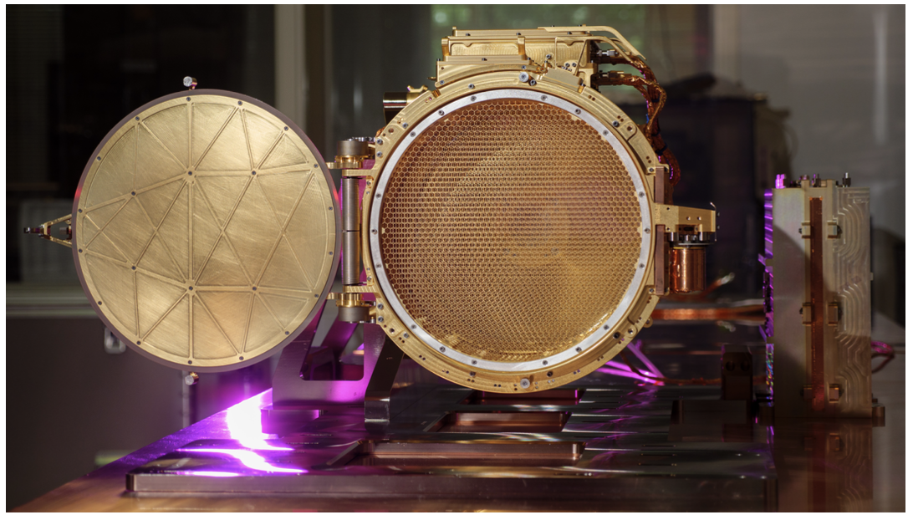
10. Europa Clipper and the surface dust analyzer (SUDA)
SUDA, the Surface Dust Analyzer, is a key instrument on the Europa Clipper mission designed to analyze micrometeorite ejecta from Europa's surface.
It utilizes metal mesh grids to measure the speed and trajectory of dust particles, pinpointing their origin on Europa's surface.
By analyzing the chemistry of these dust particles, SUDA can identify organic molecules, salts, and other compounds, shedding light on Europa's surface composition and potential for life.
SUDA's findings will help determine the origin of Europa's surface material, crucial for understanding its interior dynamics and the broader processes of material exchange among the Galilean moons.

Slide 14
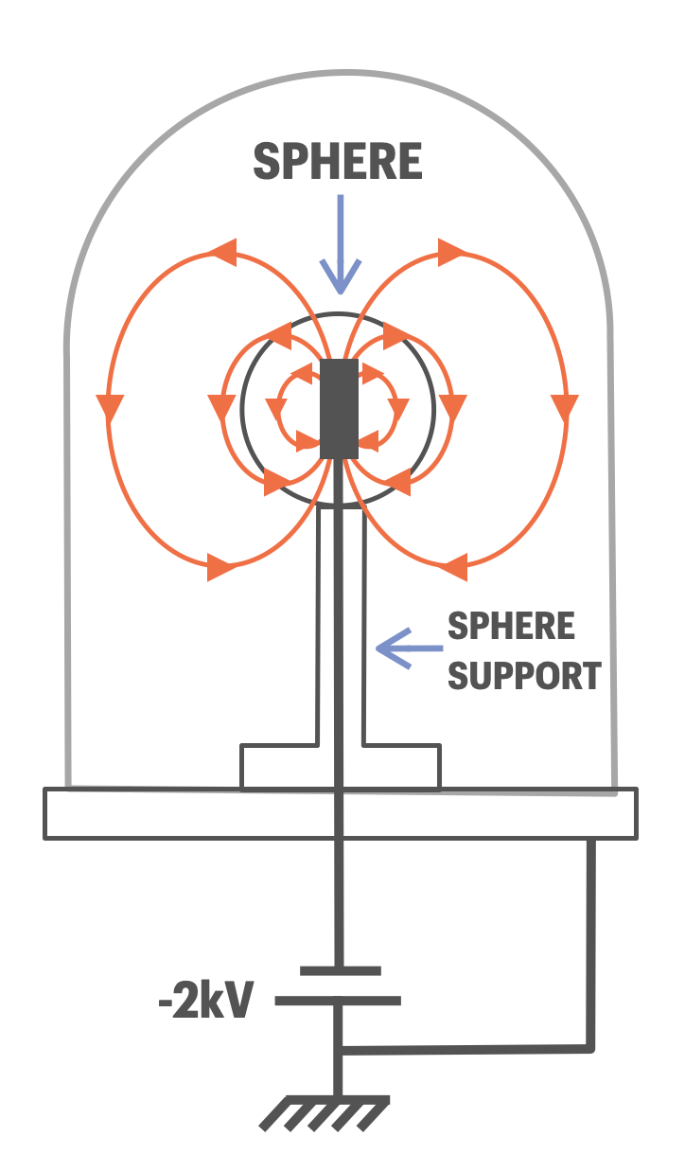
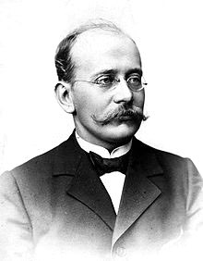
What is a Planeterrella device?
$→$ magnetic field
$→$ electric field
WILLIAM GILBERT: Queen Elizabeth I’s Physicist, built a magnetized spherical model of Earth using Lodestone to demonstrate why compasses point North, dubbed it the Terrella
First modern Terrella was built by Norwegian Physicist Kristian Birkeland after expedition
Birkeland was nominated for the Nobel prize 7 times for his work
The device consists of a negatively biased metal sphere representing a planet with a permanent bar magnet is embedded within it. The bell jar encompassing the spheres is vacuumed down with an oil pump
Kristian Birkeland

Slide 15
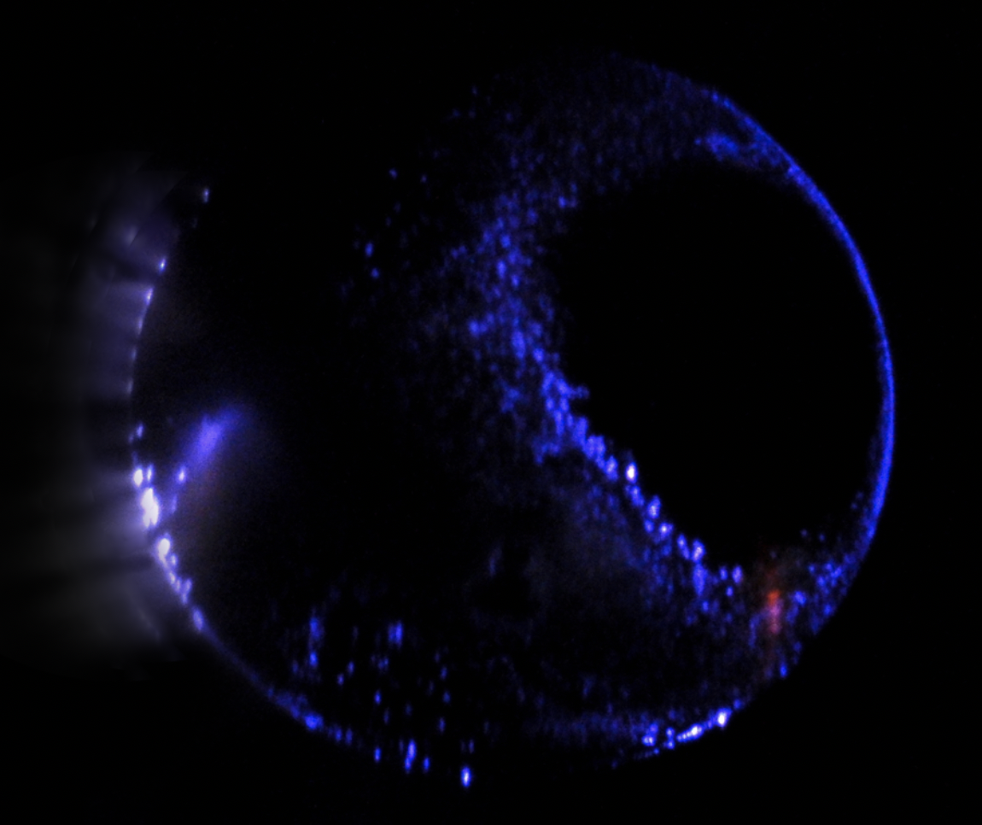
Significance of Terrella Studies: Modern Findings
”La Planeterrella” located at the French Institute of Planetology and Astrophysics in Grenoble (IPAG)
Graduate Student David Bernard used the apparatus to simulate the Aurora due to the magnetic anomalies surrounding Mars
Accomplished this by replacing the air in the chamber with the $CO_{2}$ composition in the Martian atmosphere
Based off the findings of the Ultraviolet Radiation in the Martian Atmosphere NASA mission Mars Atmosphere Volatile EvolutioN (MAVEN) spacecraft, led by Principal Investigator Bruce Jakosky of LASP

Slide 16
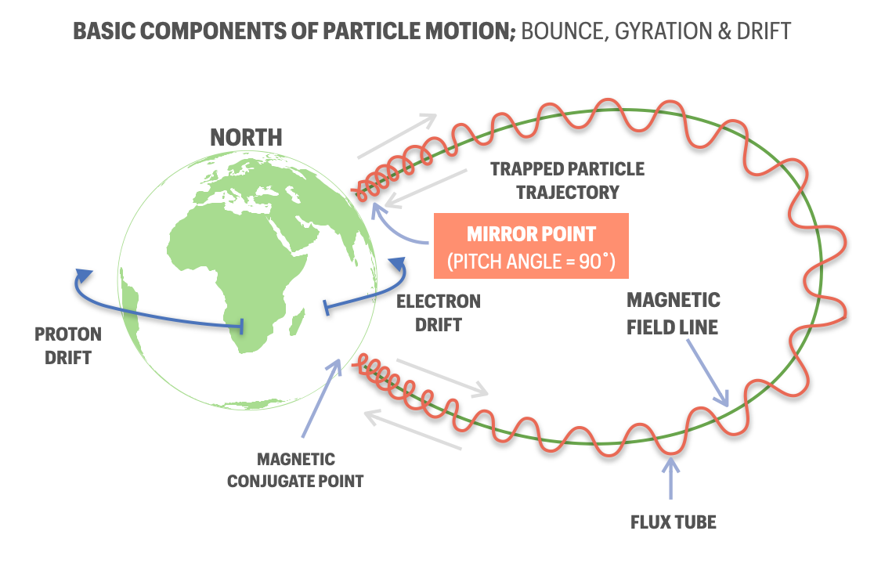
Mirroring Effects
MAGNETIC MIRROR POINTS: a point where the magnetic field becomes strong enough to reverse the drift velocity of a charged particle.
Bounce motion w/ cyclotron gyration

Slide 17
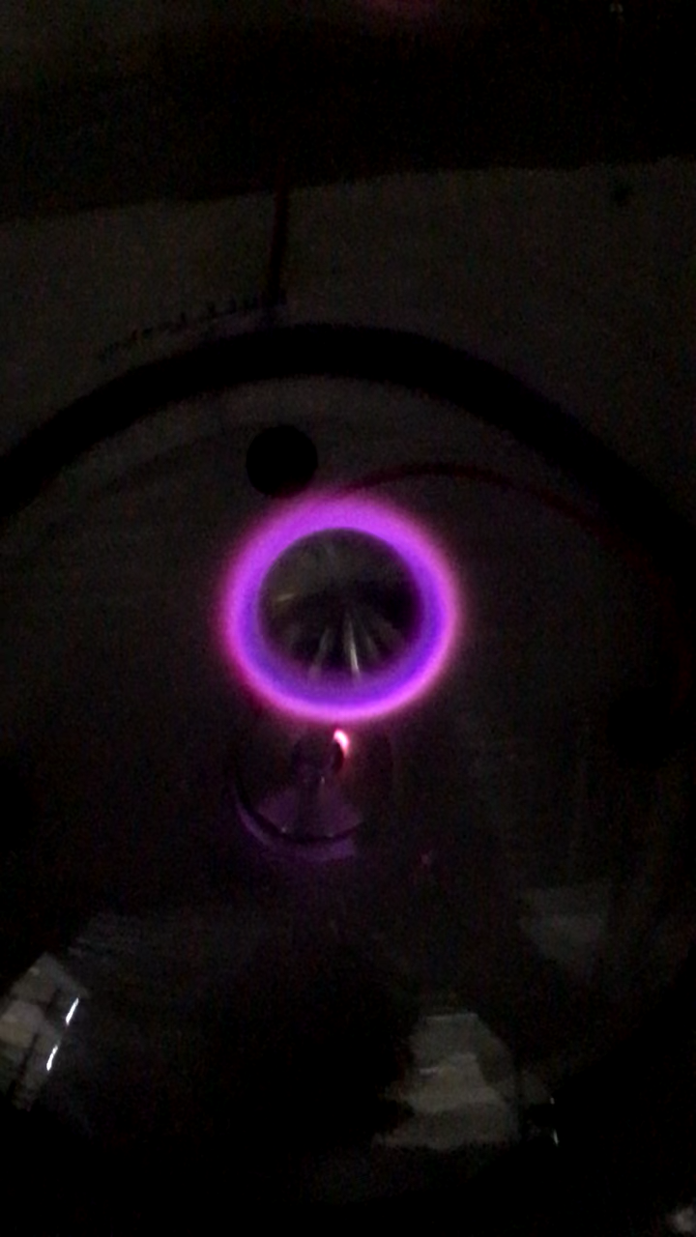
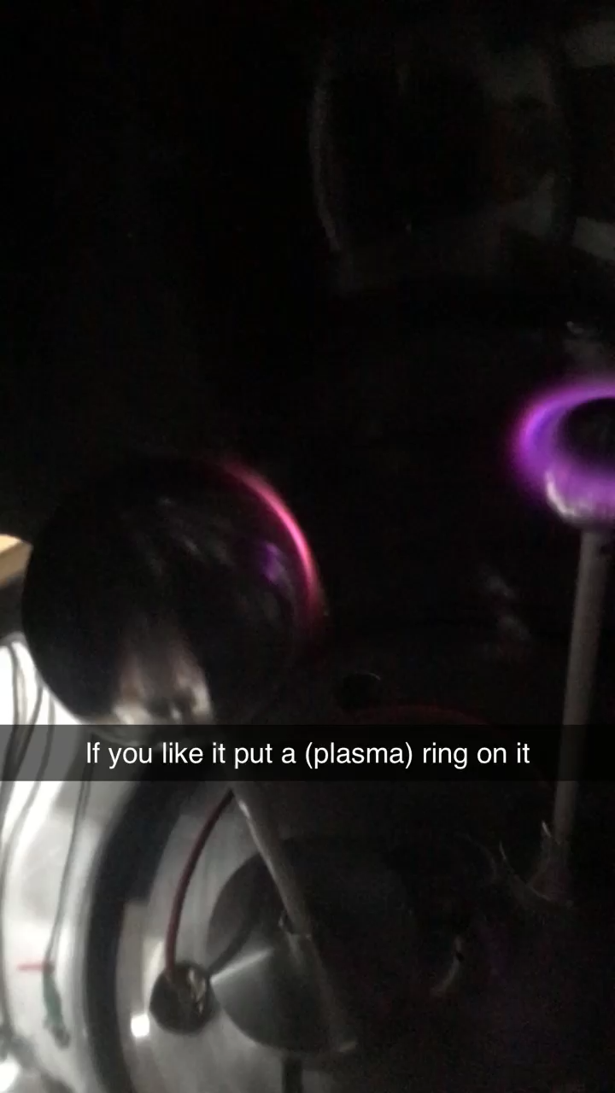
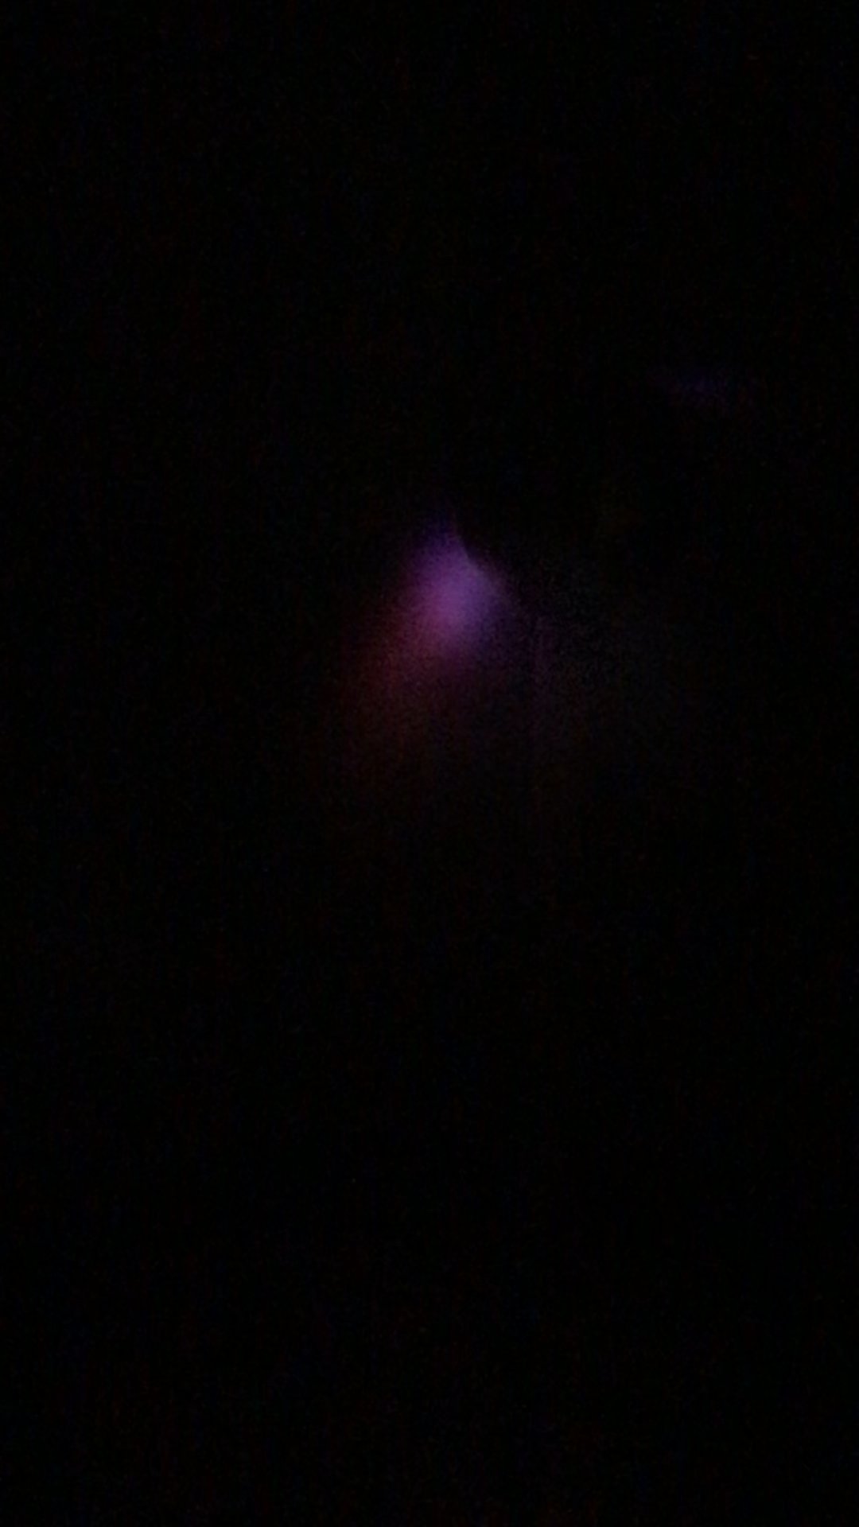
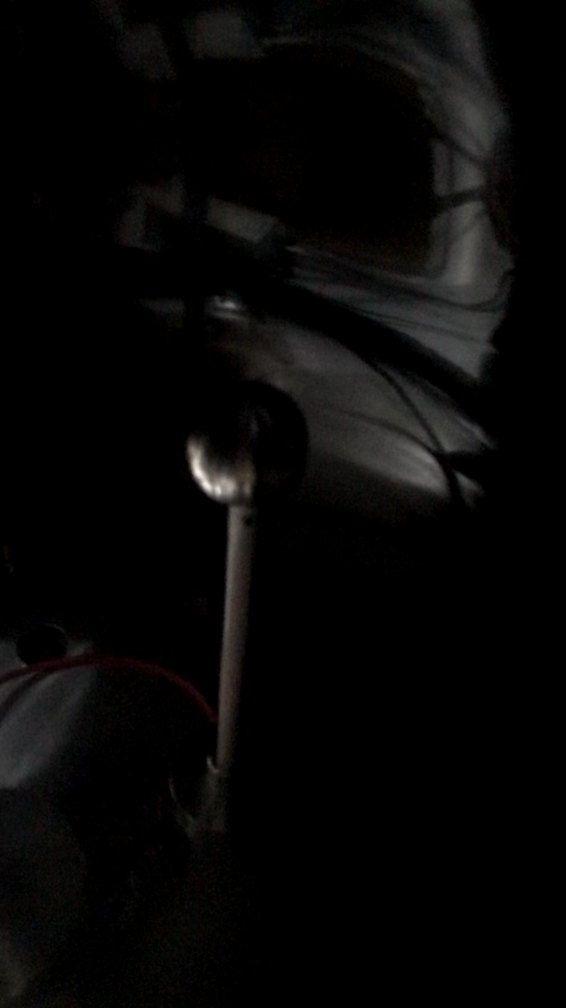
The Final product

Slide 18
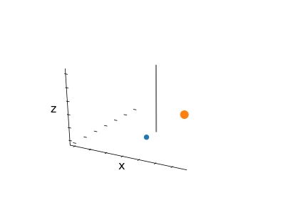
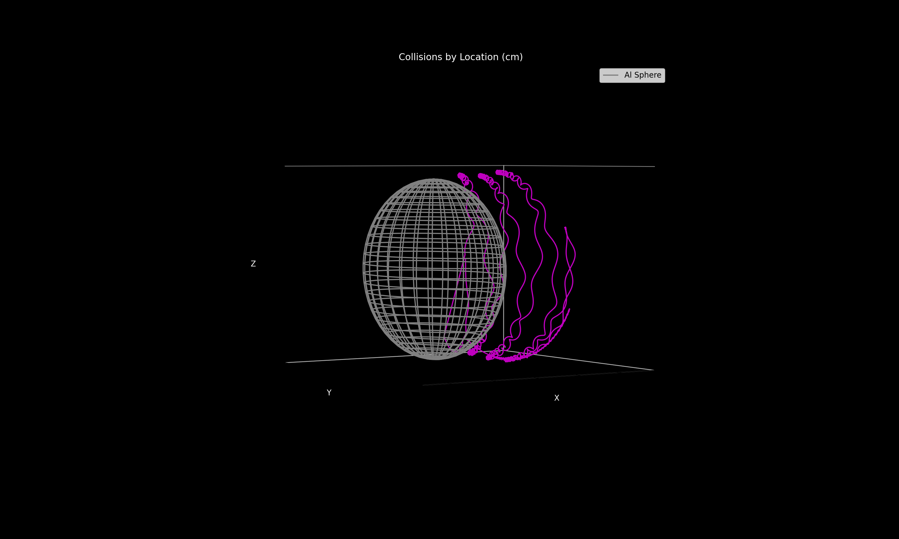
Python/FORTRAN Implementation
q = - e, high v
q = + e , low v
Discretized the equations for a dipole magnetic field and weak radial electric field (approximated using cylindrical symmetry).
Code was parallelized in FORTRAN using OpenMP
Ions ignored due to larger mass and effective cross section

Slide 19
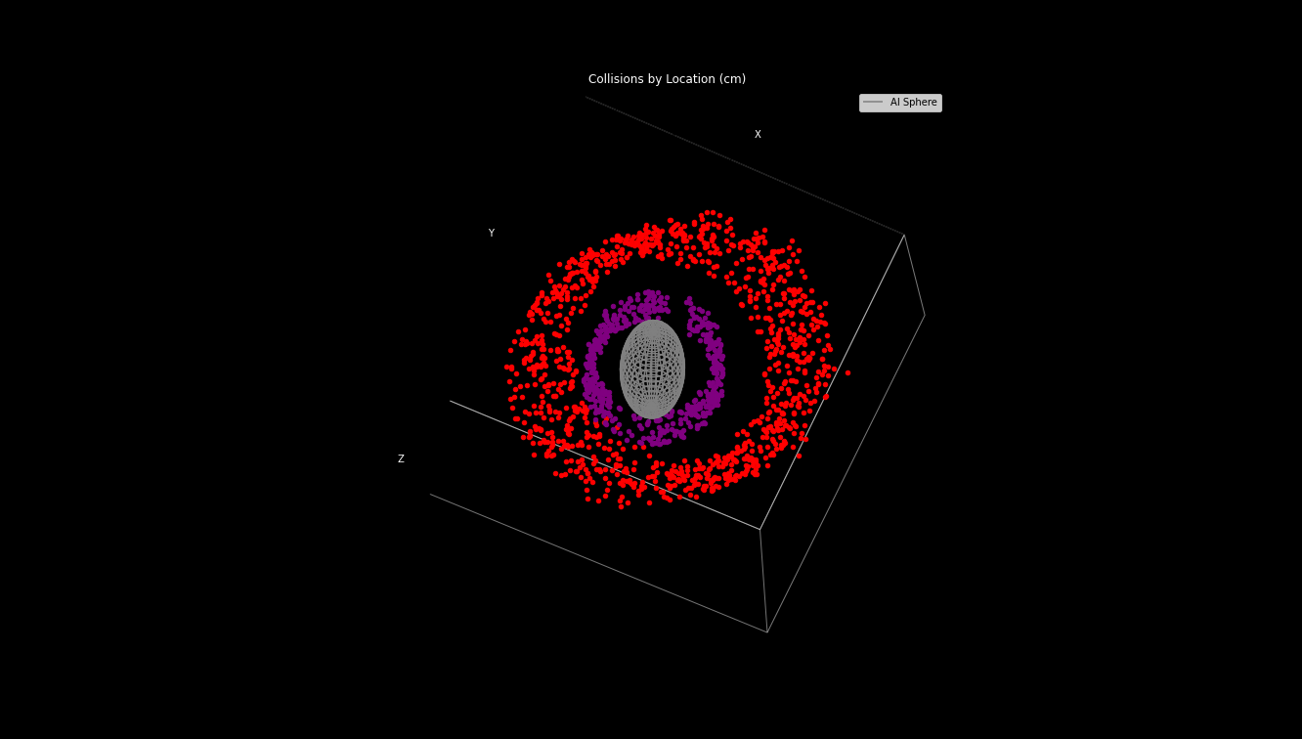
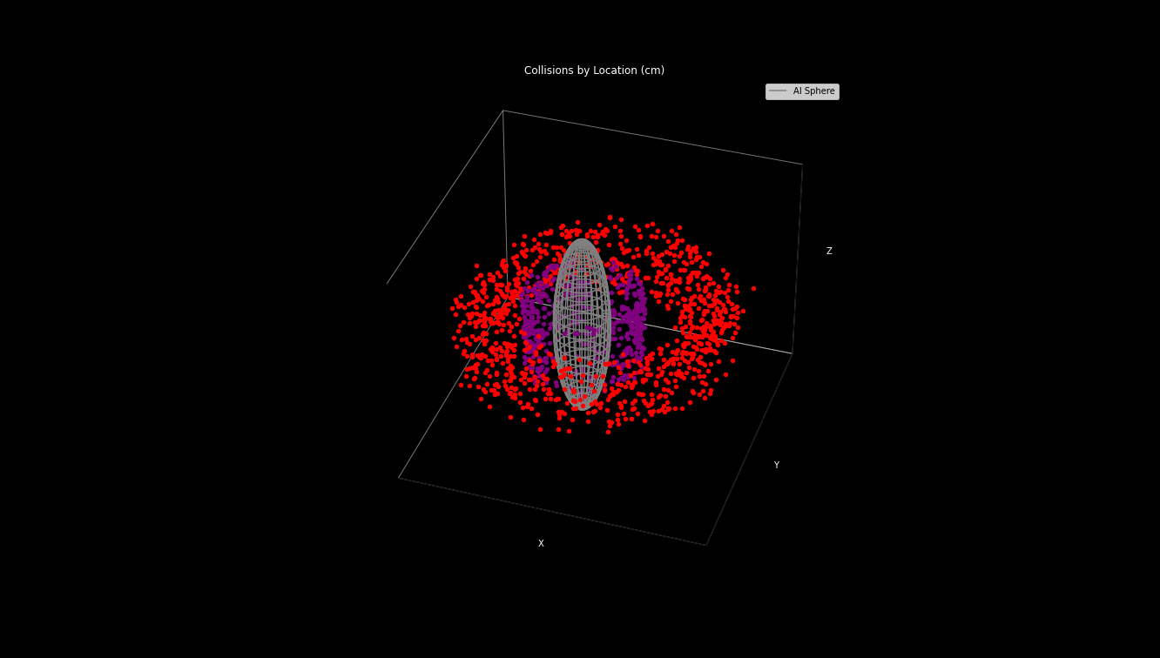
Simulation Results
By sorting our Monte-Carlo collisions based on the ionization energies of Nitrogen and Oxygen, we were able to successfully reproduce the Terrella’s ring currents.

Slide 20
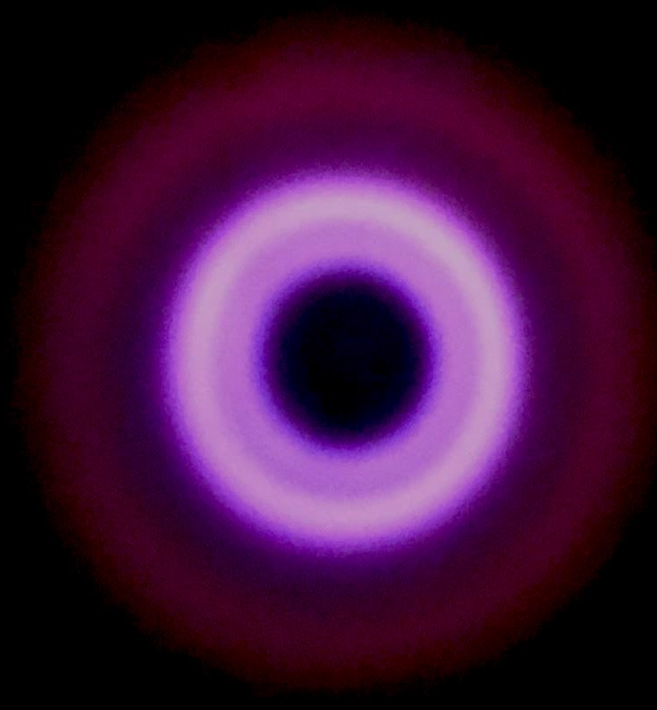
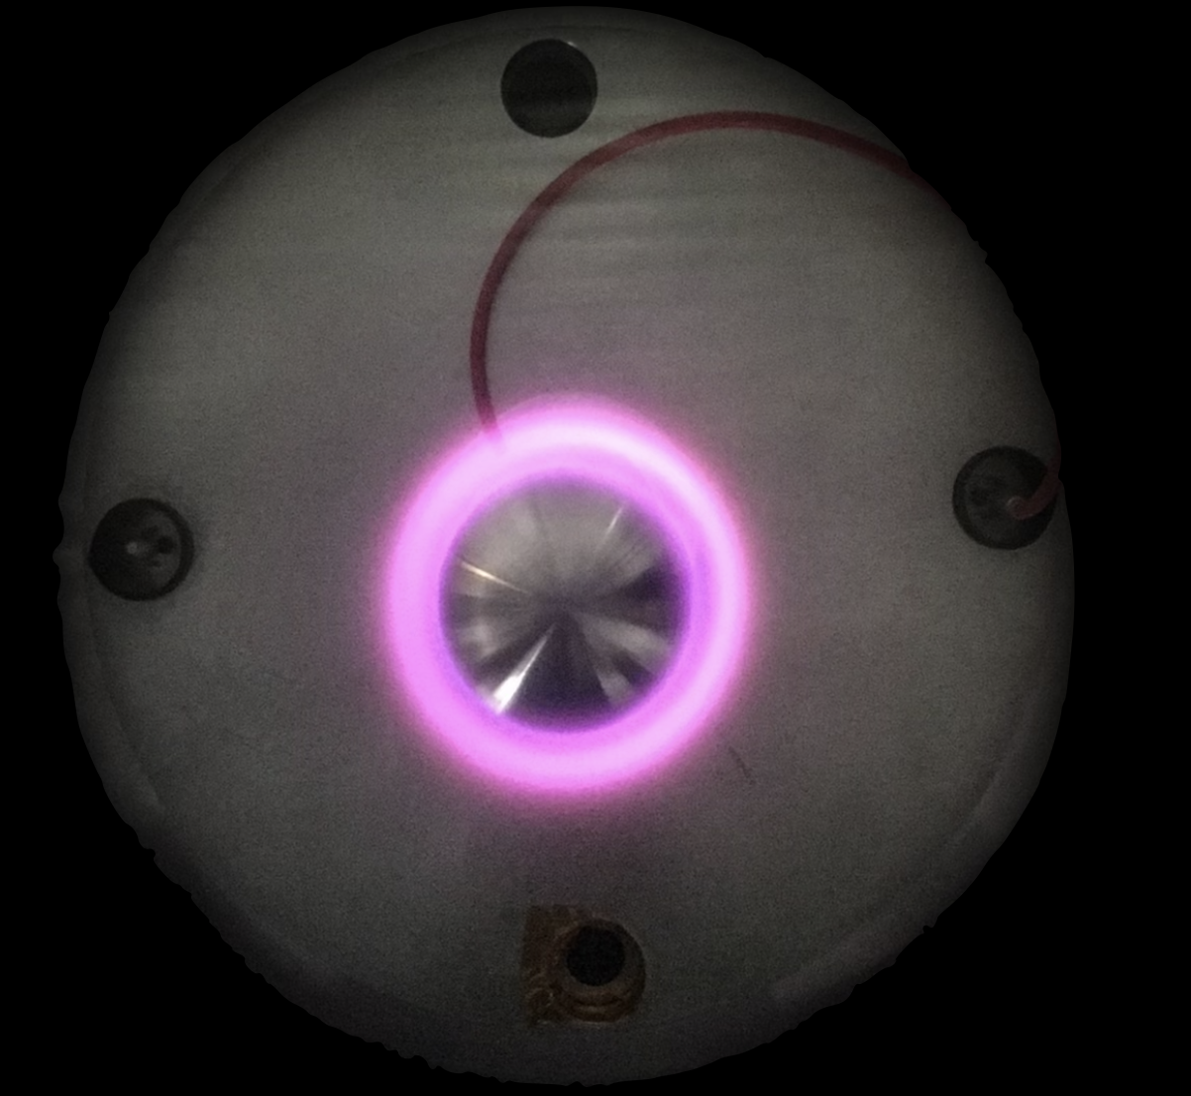
Nitrogen Experiment Results
With normal air pumped down within the chamber to 400 mTorr, pictures were taken from when the voltage first made the plasma visible, to 2kV (upper limit of the high voltage power supply) and back down to when the plasma disappeared.
It was found that applying a bias of 1600 volts resulted in the most luminescent primary and secondary rings
Then, the chamber was pumped down to ~5 mTorr, pure $N_{2}$ was filled in. The same experiment was carried out, but the oxygen ring was no longer visible (even at 1600 Volts), shown below:

Slide 21
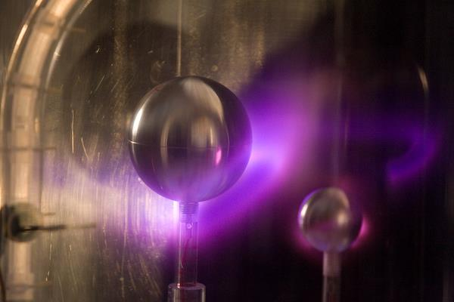
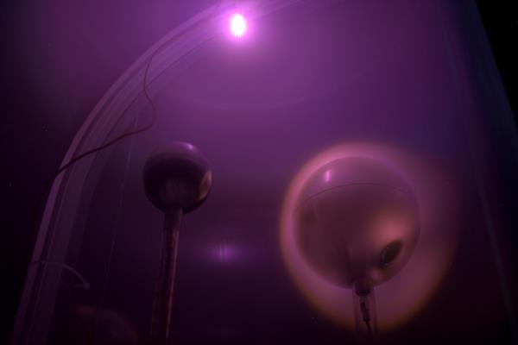
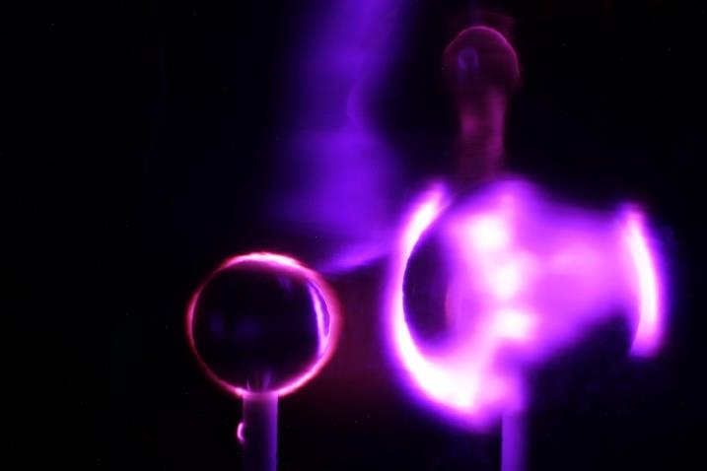
Some Possibilities
Investigate what other spectra can be produced (Based of the done on “La Planeterrella” to model the Martian Atmosphere via Blue aurora)
Pumping pure Oxygen gas ($O_{2}$) into the chamber to see if only the Red ring is visible
Vary magnet angle, simulating pole shift
Further developing the simulation to include electron-electron collisions (electron avalanche)
Modeling other astrophysical plasmas using different chamber configurations

Slide 22
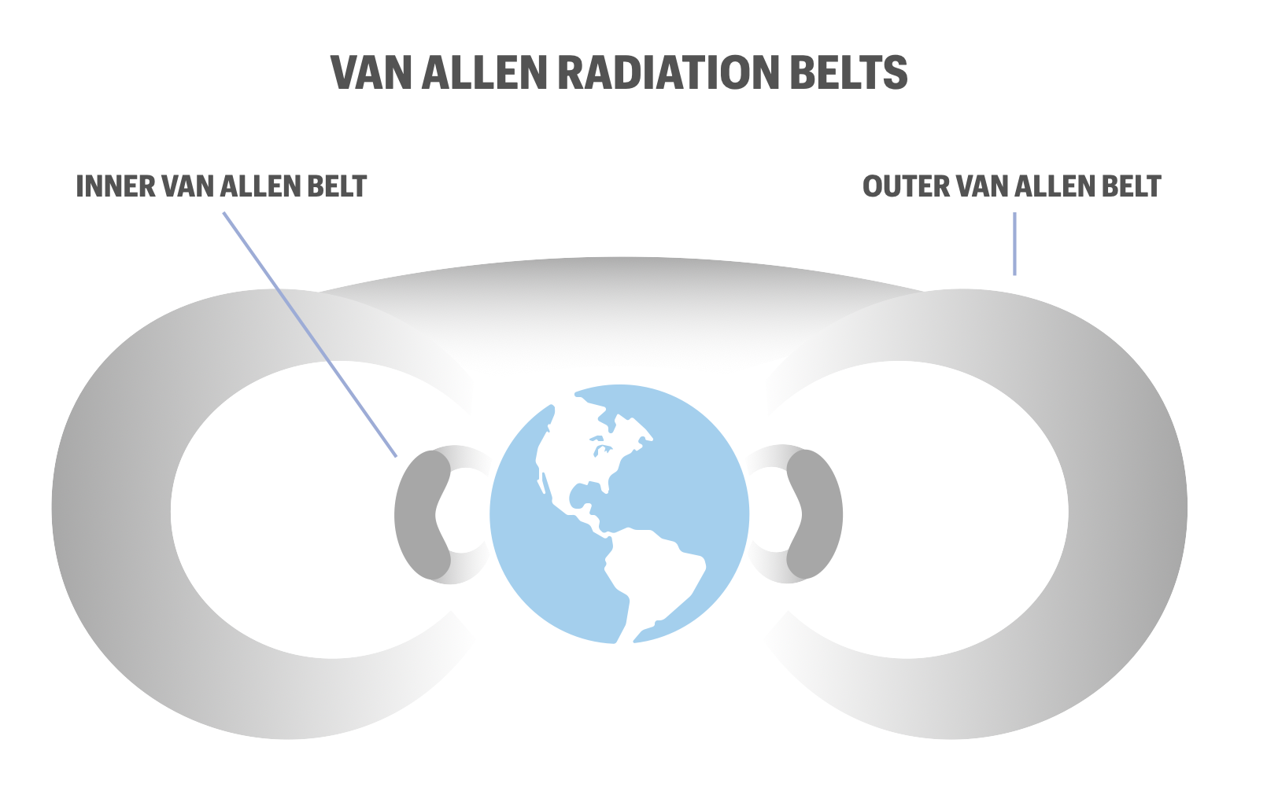
Significance of Ring Currents: The Van Allen Belts Around Earth
THE VAN ALLLEN BELTS: ring currents formed by the trapping of charged particles from solar wind within Earth’s Magnetosphere, and are currently being studied here at LASP.
GEOMAGNETIC STORMS: fluctuations in the solar wind that cause perturbations in the Earth’s magnetic field
Disturbance Storm-time(DST) Index

Slide 24
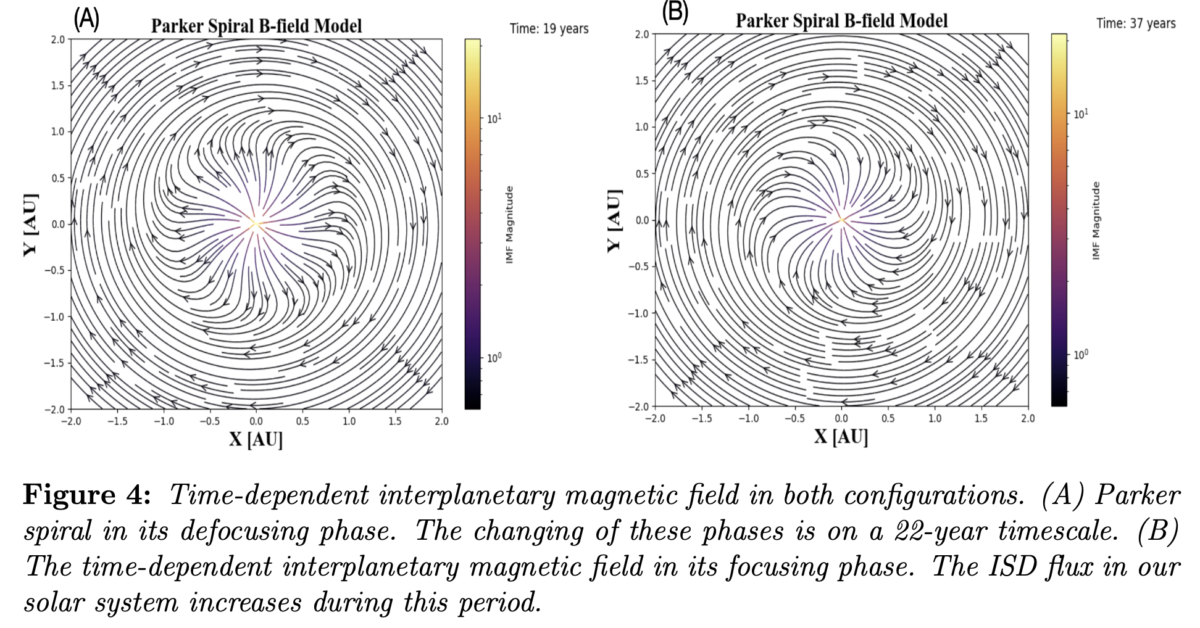
A simple, fully time-dependent Parker spiral
$$\begin{matrix}{\overset{⃗}{B}}_{R} & =B_{0}{\left(\frac{r_{0}}{\overset{⃗}{r}}\right)}^{2}cos\left(\frac{πt[\text{yr}]}{11}+ϕ_{0}\right)\text{, and} \\ {\overset{⃗}{B}}_{T} & =B_{0}\frac{r_{0}}{\overset{⃗}{r}}cosθcos\left(\frac{πt[\text{yr}]}{11}+ϕ_{0}\right).\end{matrix}$$
2-D simplification: Here, the coordinate system is 2-D in the elliptic plane of our solar system
Time dependence: The 22-year solar cycle is captured by the sinusoidal terms

Slide 25
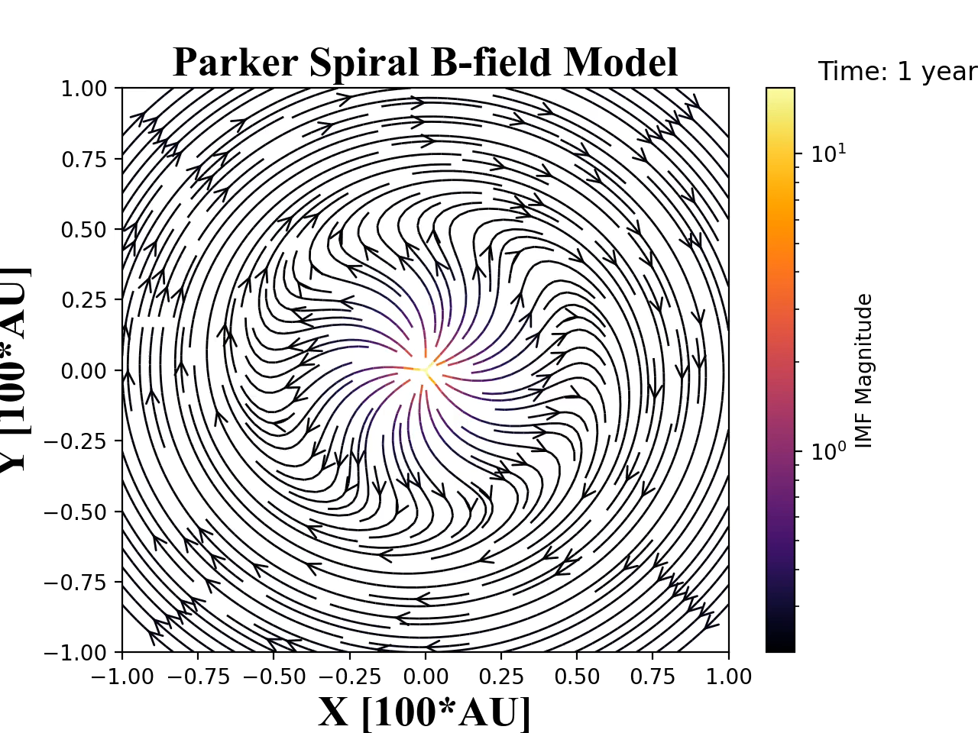
A simple, fully time-dependent Parker spiral
Focusing/Defocusing cycles: Here, the streamlines indicate magnetic field line direction
Units: Here, the distance axes are given in hundreds of AU in a heliocentric coordinate system
Field magnitude: The B-field strength has been normalized, indicated by the color of the streamlines

Slide 26
Runge-Kutta
Simulation Development
Given a timestep $h$ & number of iterations $N$, we have the following algorithm:
Let $h=\frac{(b-a)}{N}$, $t=a,$and $w=V_{0}$
STEP 1
Only followed the trajectories of the electrons
This is valid because the neutrals are much more massive and have larger cross sections
Algorithm that repeatedly updates position and velocity initial conditions to solve the following differential equation:
STEP 2
While $i≤N,$perform steps 3-5
STEP 3
Since we are implementing a fourth-order Runge-Kutta method, we define 4 FUNCTIONS:
$K_{1}=hf(t_{i},V_{0,i})$$K_{2}=hf(t_{i}+\frac{h}{2},V_{0,i}+\frac{K_{1}}{2})$
$K_{3}=hf(t_{i}+\frac{h}{2},V_{0,i}+\frac{K_{2}}{2})$$K_{4}=hf(t+h,V_{0,i}+K_{3})$
STEP 4
Let $V_{0,i+1}=V_{0,i}+\frac{(K_{1}+2K_{2}+2K_{3}+K_{4})}{6},$and $t_{i+1}=ih$
$$\frac{d{\overset{⃗}{v}}_{i+1}}{dt}=\frac{q}{m}(\overset{→}{E_{i}}+\overset{→}{v_{i}}×\overset{→}{B_{i}})$$
STEP 5
Output $(t_{i},x_{i},x_{i}^{′})∀_{i}$
K1 = slope at the beginning of the timestep interval,$[t_{i},t_{i+1}]$. If K1 is used to approximate the function halfway through the timestep, then K2 is the slope at the midpoint. Once K2 is obtained we return to the beginning of the timestep and use it to obtain yet another midpoint slope estimation, which is K3. After K3 is obtained, it is used to approximate the function until the end of the timestep interval. Finally, at the end of the interval an endpoint slope estimation is made, which is K4.

Slide 27
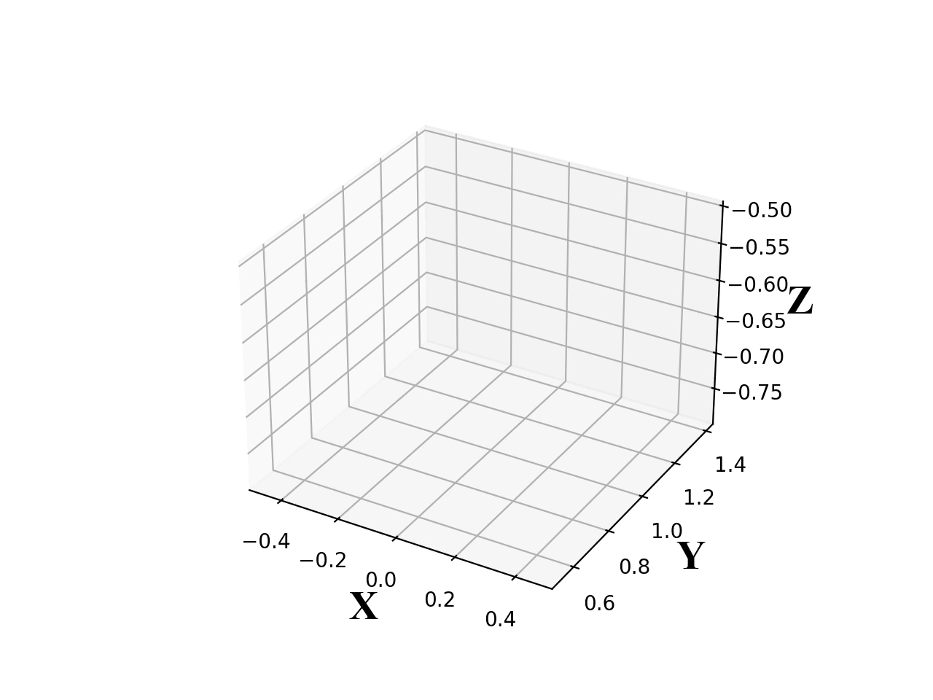
Significance of Ring Currents: The Van Allen Belts Around Earth
FORTRAN-based integration: A Python-based frontend allows the user to specify the initial conditions (State vector = <x, y, z, v_x, v_y, v_z >, dust parameters q & m and fields E,B in cartesian parameters
PARAMETERS: To run the code, the parameters U, R, B_0, r_0, phi_0 and theta_0 must be provided so the magnetic field equation in cartesian coordinates can be evaluated:
B_x = U * y + B_R * x / rsq - B_T * y / rsq
B_y = -U * x + B_R * y / rsq + B_T * x / rsq
Here, R specifies the size of the grid that the magnetic field is calculated over. In this case, it is set to 100 AU for the size of the heliosphere

Slide 28

Test particles
TIME EVOLUTION: At each timestamp $t_{i}$, both the particle’s equation of motion and the magnetic field equation is evaluated to find the particle’s location, velocity and corresponding forces

Slide 29
Future dust instruments (Imap/idex)
60 cm
Incoming Dust
Impact Ions
Target Charge Signal
Detector
Ion Grid Signal
TOF Mass Spectrum
News video: https://youtu.be/RYf99iiwdPg.

Slide 30
2. Implications for biology
Focused on two photochemical processes. Surface radiance is used to calculate the “biologically effective dose rate (BED)”. Relevant for the RNA world hypothesis, where life on Earth began with a simple RNA molecule that could copy itself without help from other molecules.
Uridine Monophosphate (UMP) photolysis:
N-Glycosidic Bond Cleavage
“Measures a stressor for abiogenesis”.
UMP is an RNA monomer. “When irradiated by UV, UMP cleaves the glycosidic bond that joins the nucleobase to the sugar” (bad for biology).
CuCN3 Cyanocuprate photoionization:
Photoionization
“Measures a eustressor for abiogenesis”.
Produces aquated electrons relevant for glycoaldehyde and glyceraldehyde production. This can then produce nucleotides and amino acids

Slide 31
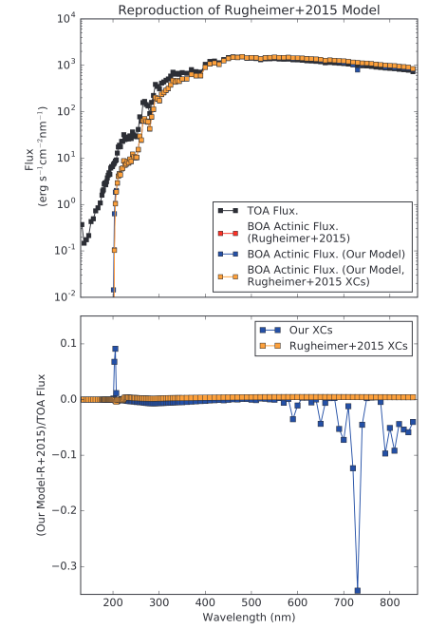
3. Model validation
In order to validate their two-stream radiative transfer model, Ranjan and Sasselov compared their calculations to published works. The flux as a function of wavelength is compared to the Rugheimer, 2015 model of the 3.9 Ga Earth (upper right).
The difference between the Rugheimer 2015 and this model’s flux was calculated using both their cross sections and the other (lower right). In both cases, the model well reproduces the results of Rugheimer, 2015.

Slide 32
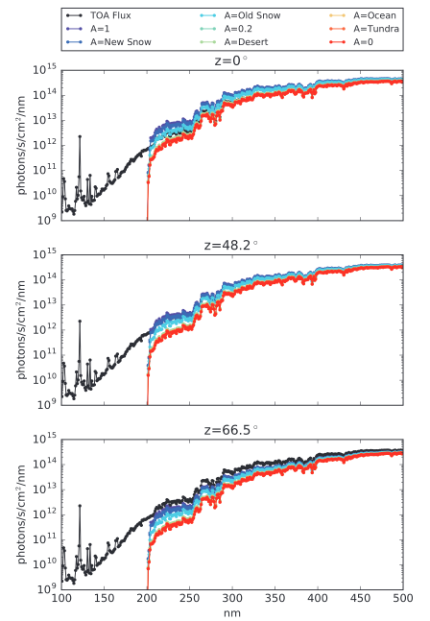
4. Effects of Albedo and Zenith Angle on Surface UV Fluence
Assuming an atmosphere corresponding to the model of Rugheimer et al. (2015) and a range of solar zenith angles and surface albedos, variations in spectral surface radiance can be as high as a factor of 20.6 for wavelengths greater than 204 nm at a 1 nm resolution. This applies to Earth's surface radiance at 3.9 Ga, indicating that albedo and zenith angle must be considered for these calculations.

Slide 33
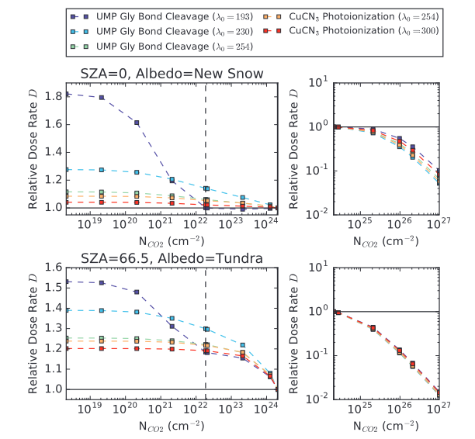
5. Dependence on Atmospheric Composition (CO2)
CO2: Strong shielder at sufficient densities. for NCO 2 ‡ 2.09 · 1023 cm-2, photons shortward of 193 nm are effectively completely blocked from the surface

Slide 34
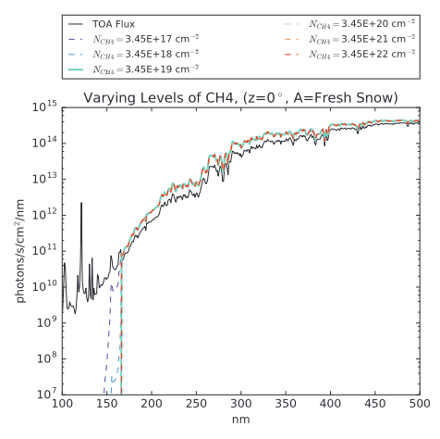
5. Dependence on Atmospheric Composition (CH4)
CH4: Ineffective shielder.
A CH4 level of NCH4 = 3.45 e 22 cm-2 is needed to extinct the fluence short-
ward of 165 nm.

Slide 35
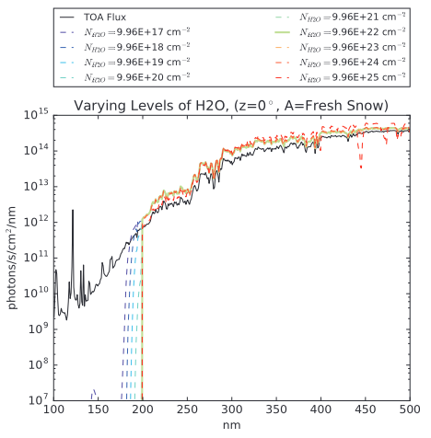
5. Dependence on Atmospheric Composition (H2O)
H2O: Strong absorber, but likely not enough water vapor on prebiotic Earth.
NH 2 O = 9.96 · 10 21 cm-2 (0.1 · the Rugheimer
et al., 2015, level) is enough to block fluence for wavelengths < 198 nm.

Slide 36
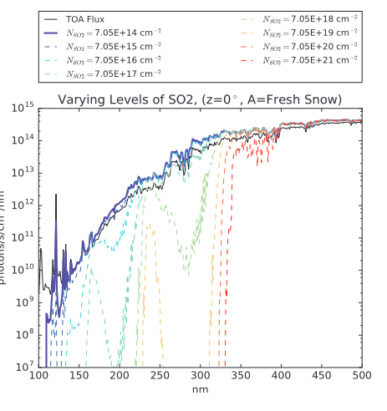
5. Dependence on Atmospheric Composition (SO2)
SO2: Higher absorber than CO2, but prone to loss processes. Possibly higher levels due to volcanic activity
At NSO 2 = 7.05 ·e17 cm-2, SO2 starts to sharply reduce fluence at wavelengths
(<=200 nm. For NSO2 ‡ 7.05 · 10 20 cm-2 (*36 ppm in theRugheimer et al., 2015, model), all fluence shortward of 327 nm is shielded out.

Slide 37
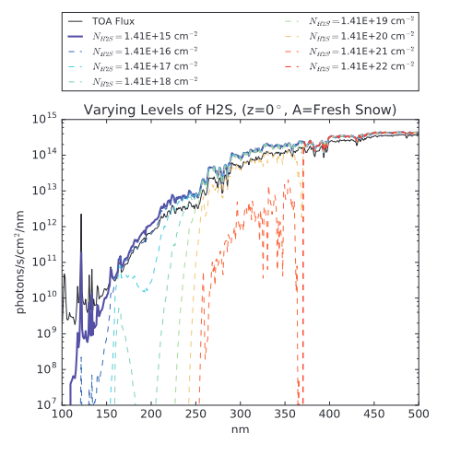
5. Dependence on Atmospheric Composition (H2S)
H2S: stronger and broader absorber than O2, also generated from volcanic outgassing, also vulnerable to photolysis and reactions with oxidants. Therefore not considered a major constituent of the atmosphere.

Slide 38
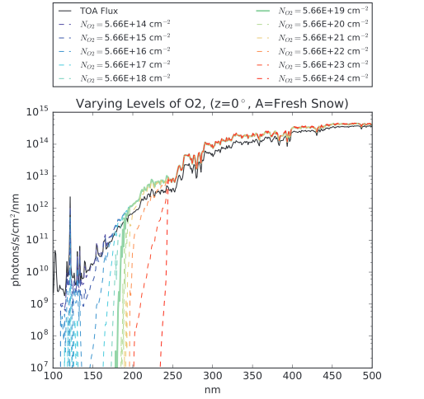
5. Dependence on Atmospheric Composition (O)
O2: Not enough of it or O3 to effectively shield the 3.9 Ga Earth
At the Rugheimer et al. (2015) level of NO 2 = 5.66 ·1019 cm-2
, O2 blocks fluence at l < 183 nm. Two orders of magnitude less than CO2.

Slide 39
THANK YOU!
ETHMAN Ethan RUSSELL ayari
ethan.ayari@lasp.colorado.edu

Slide 40
THANK YOU!
ETHMAN Ethan RUSSELL ayari
ethan.ayari@colorado.edu
(303)-549-3424

